Slide 1

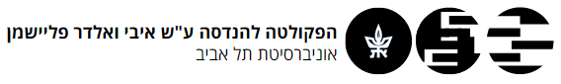
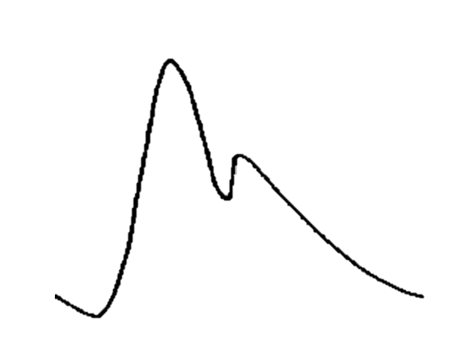
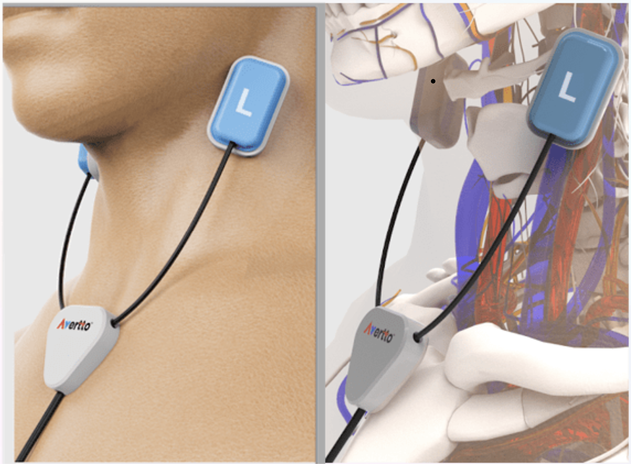
Pulse waves
Scorer
By: Noa Gelber & Amit Gavish & Amit Hadar
Advisors: Lior Toledano & Sam Zibman
Project Number:
Date:

Slide 2




Humanity Improvements
Avertto’s Mission
Critical Need:
Current Solutions
Stroke is a leading cause of death and disability, especially for those over 60
Existing methods lack real-time solutions
Innovation
Avertto's continuous monitoring offers a game-changing solution accessible at home and in hospitals.

Slide 3


Project Goal
Avertto’s Goal
Develop a medical device for real-time pulse analysis to detect potential stroke indicators.
Our Goal
Create a deep learning model that assesses data quality for accurate stroke prediction.

Slide 4
Methodology
Data collection
1
Base line
2
DL models
3

Slide 5





Collecting the Data
Records of pulse waves
Learning
Rating 1.0
Rating 2.0
Using Avertto's proprietary sensor technology
Pulse waves dynamics and rating methodology
Rating Pulse waves and creating the database
Rating Pulse waves and enhancing the data
Step 1
Step 2
Step 3
Step 4

Slide 6
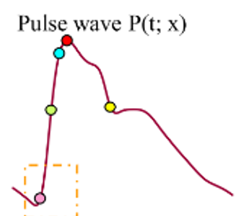
Rating Methodology
Waveform peak
Dicrotic Notch
Waveform foot

Slide 7
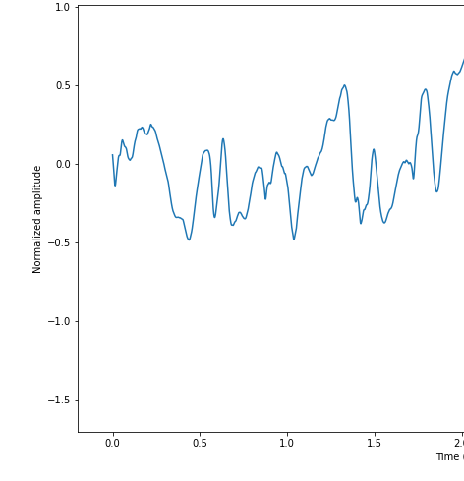
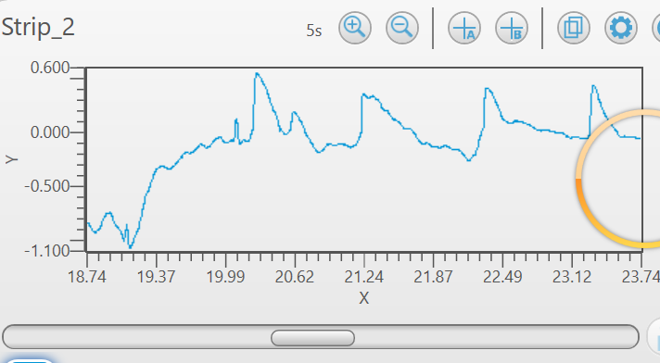
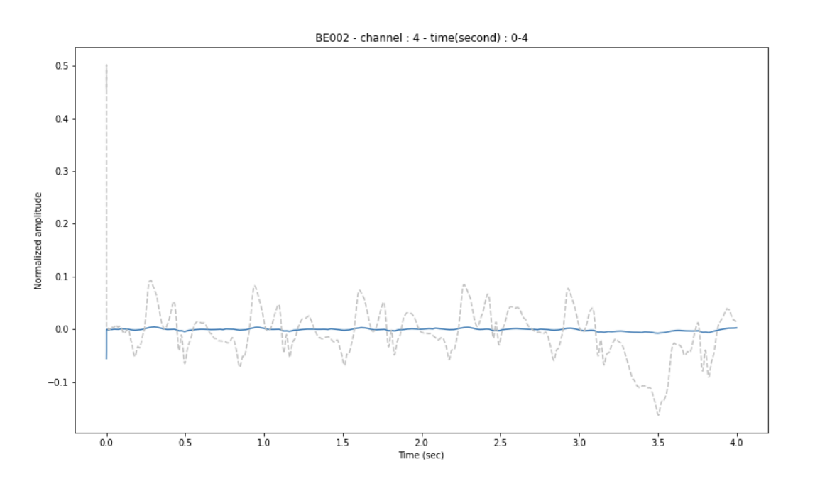

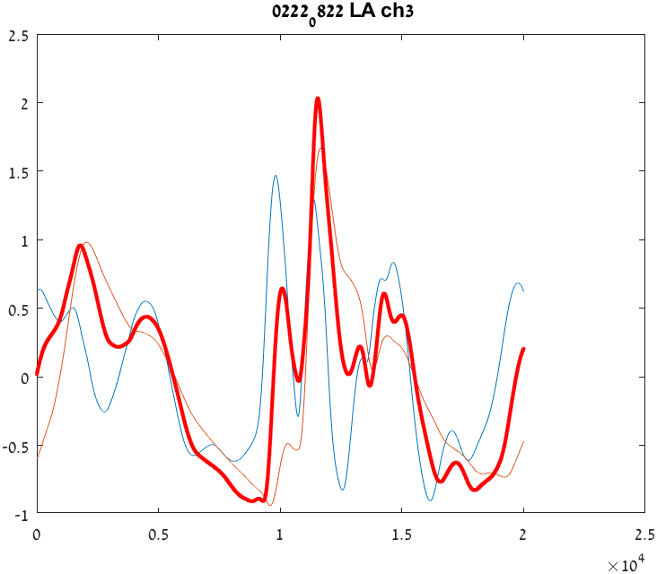
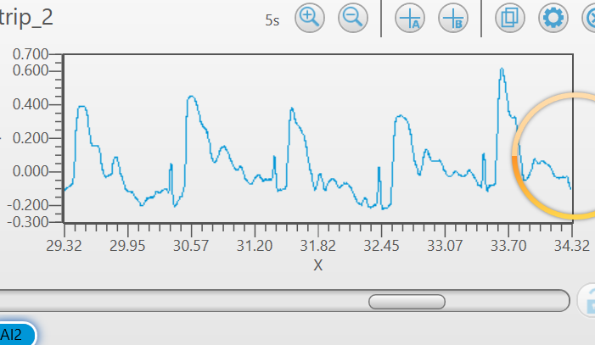
Rating Methodology
It’s a skill!

Slide 8
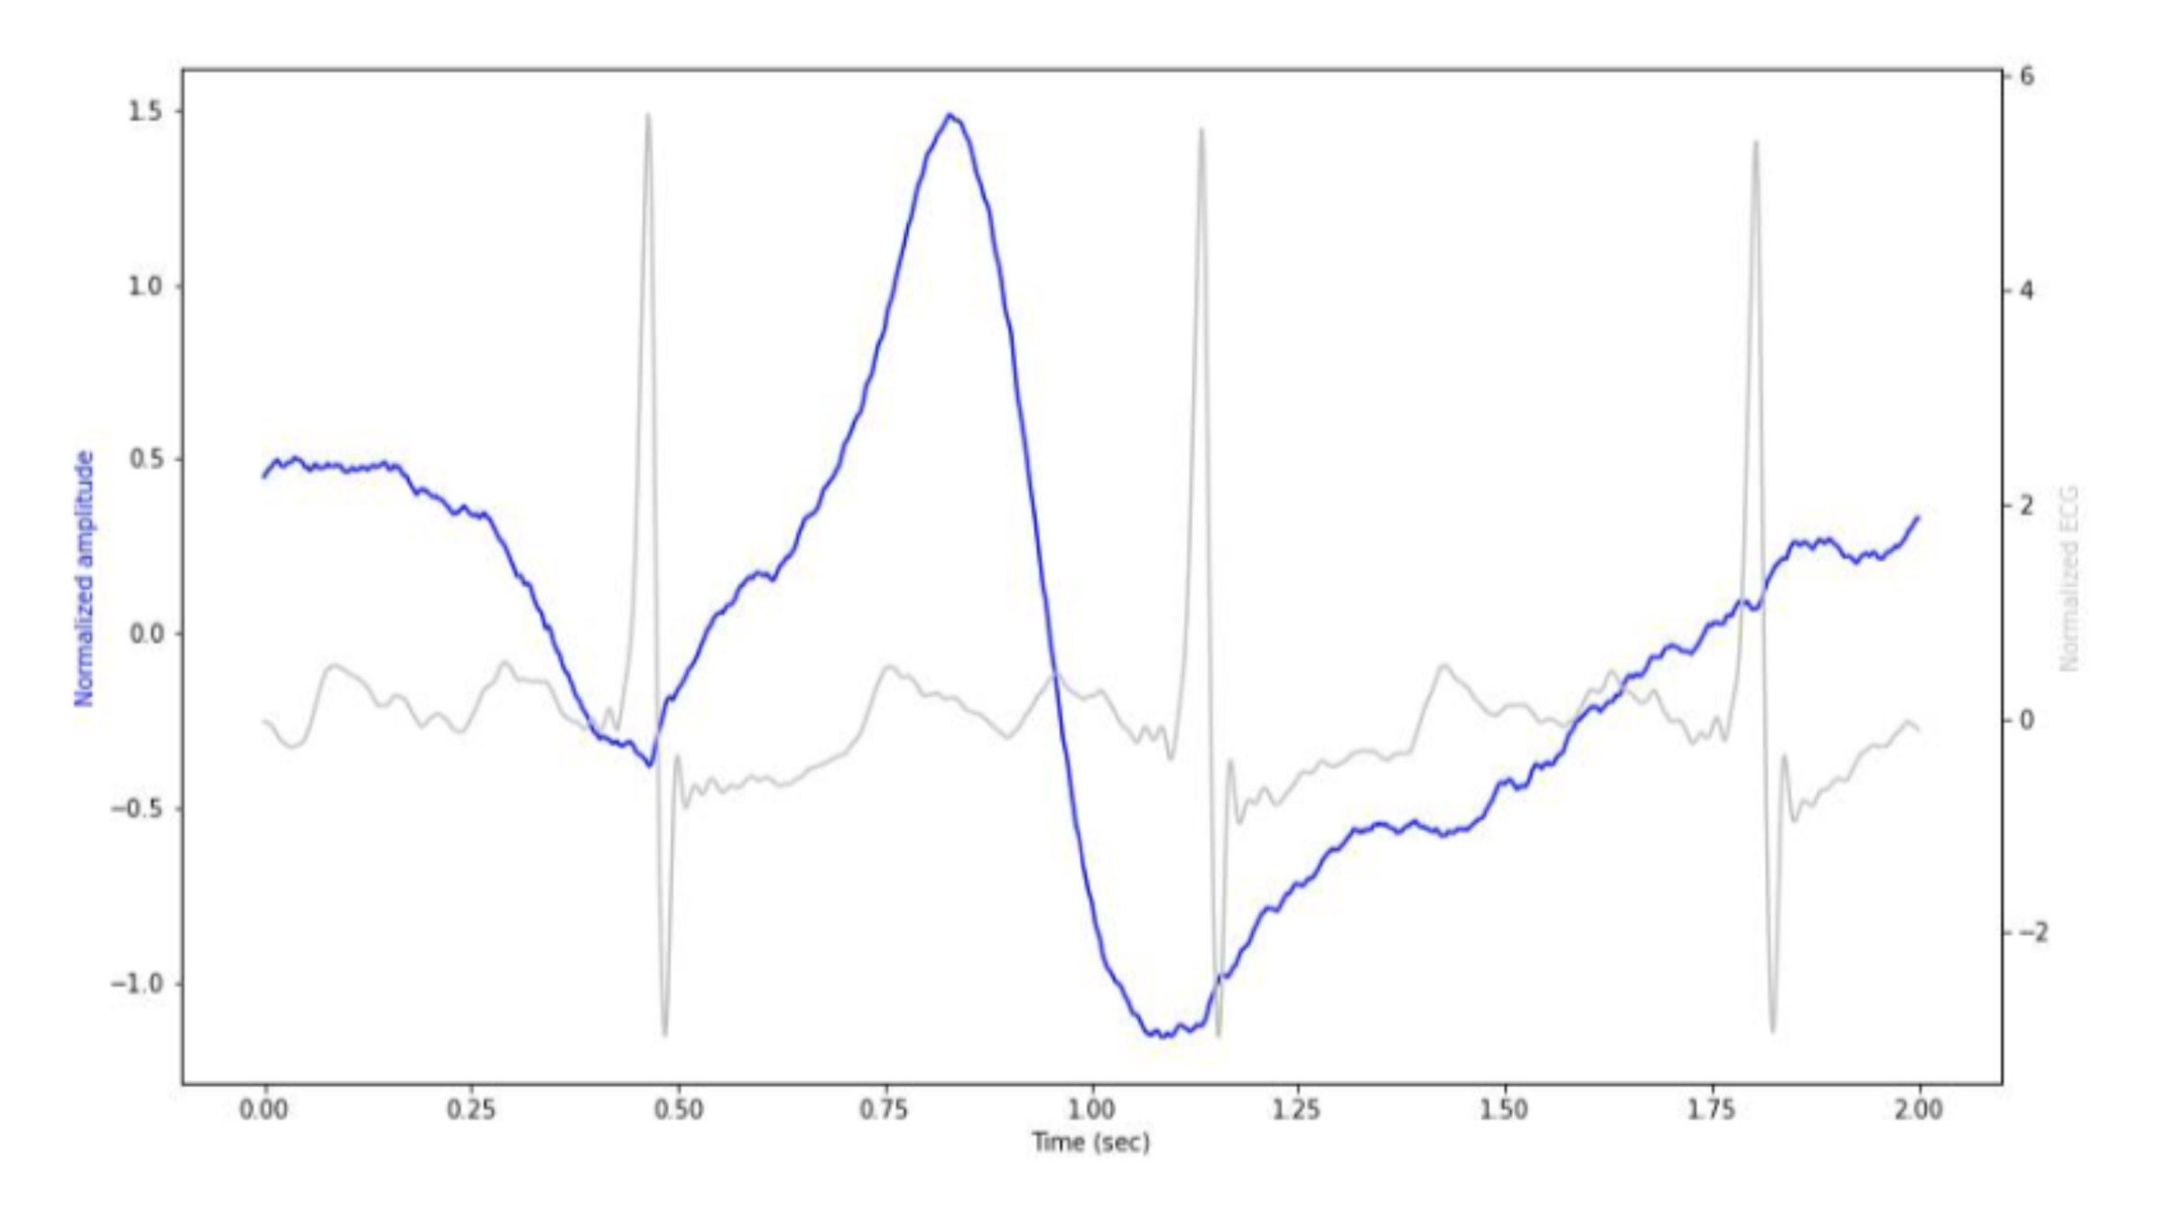
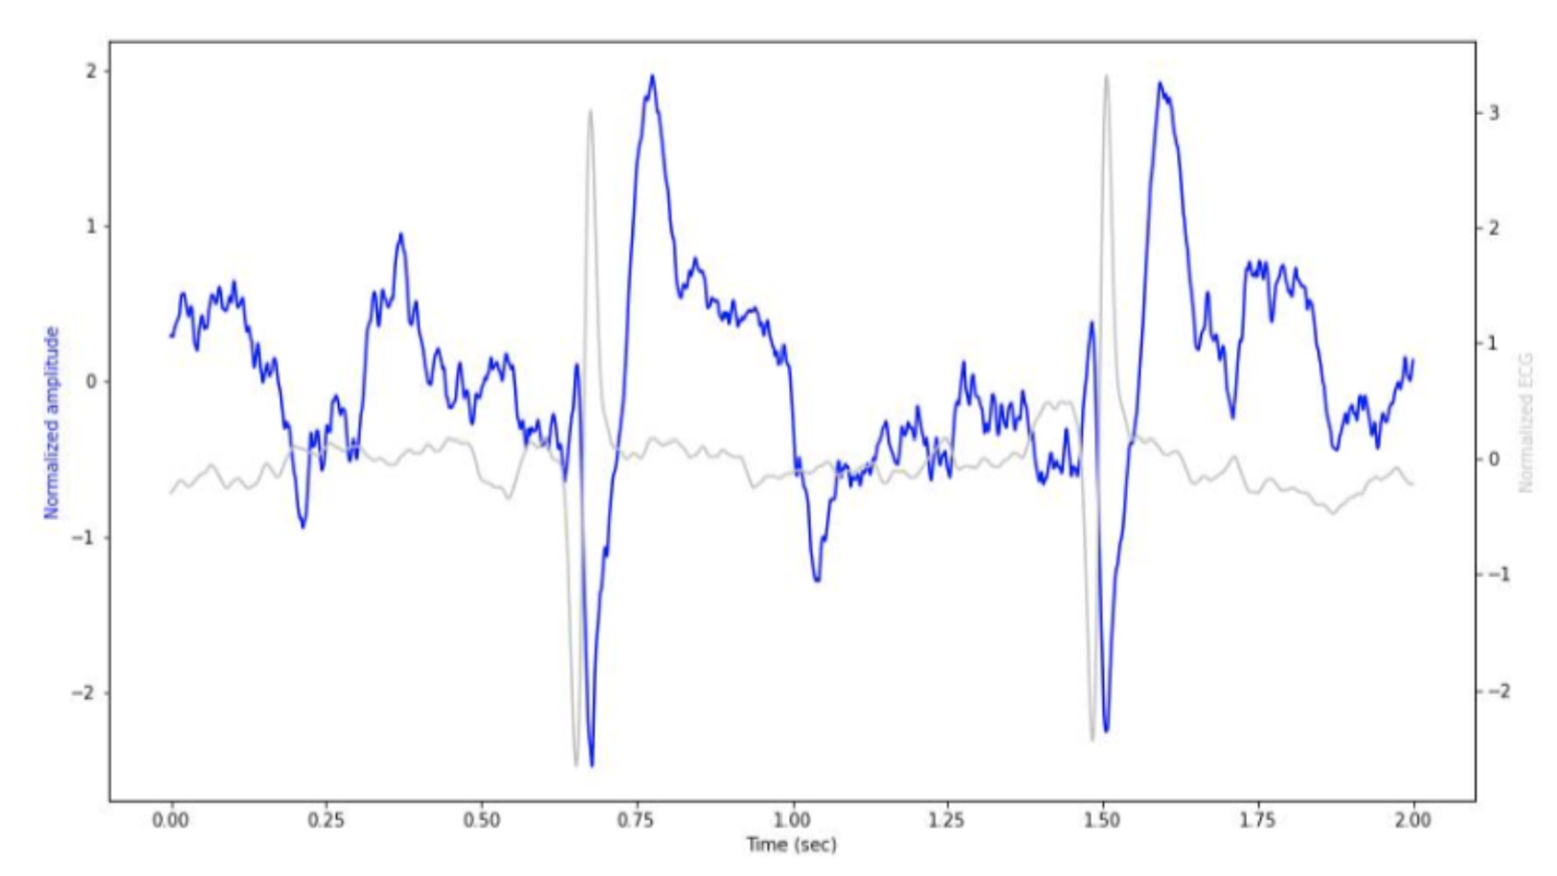


Now you try!

Slide 9
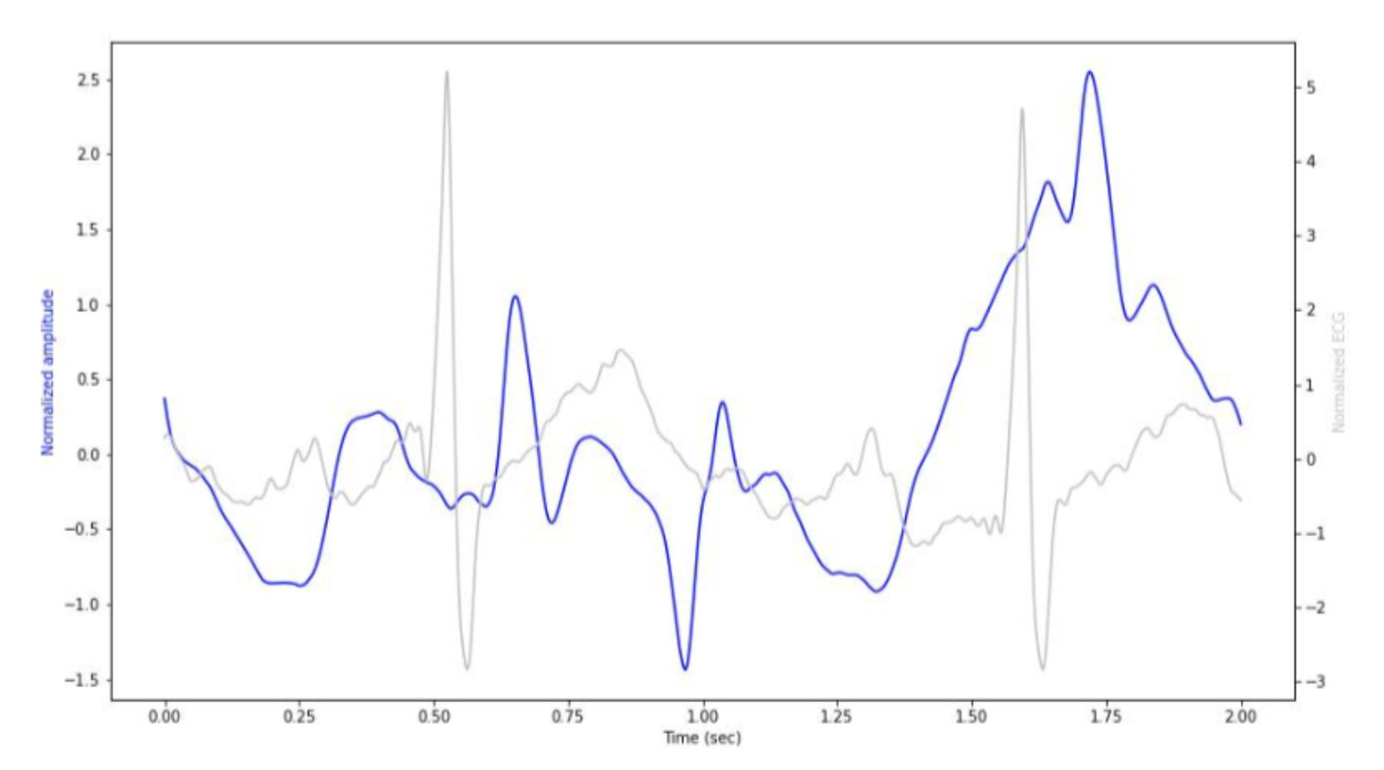
Now you try!

Slide 10









Base line
Main functionality
Importing the Data
Labels reduction
Creating segments
Models
Training loop
Evaluation

Slide 11
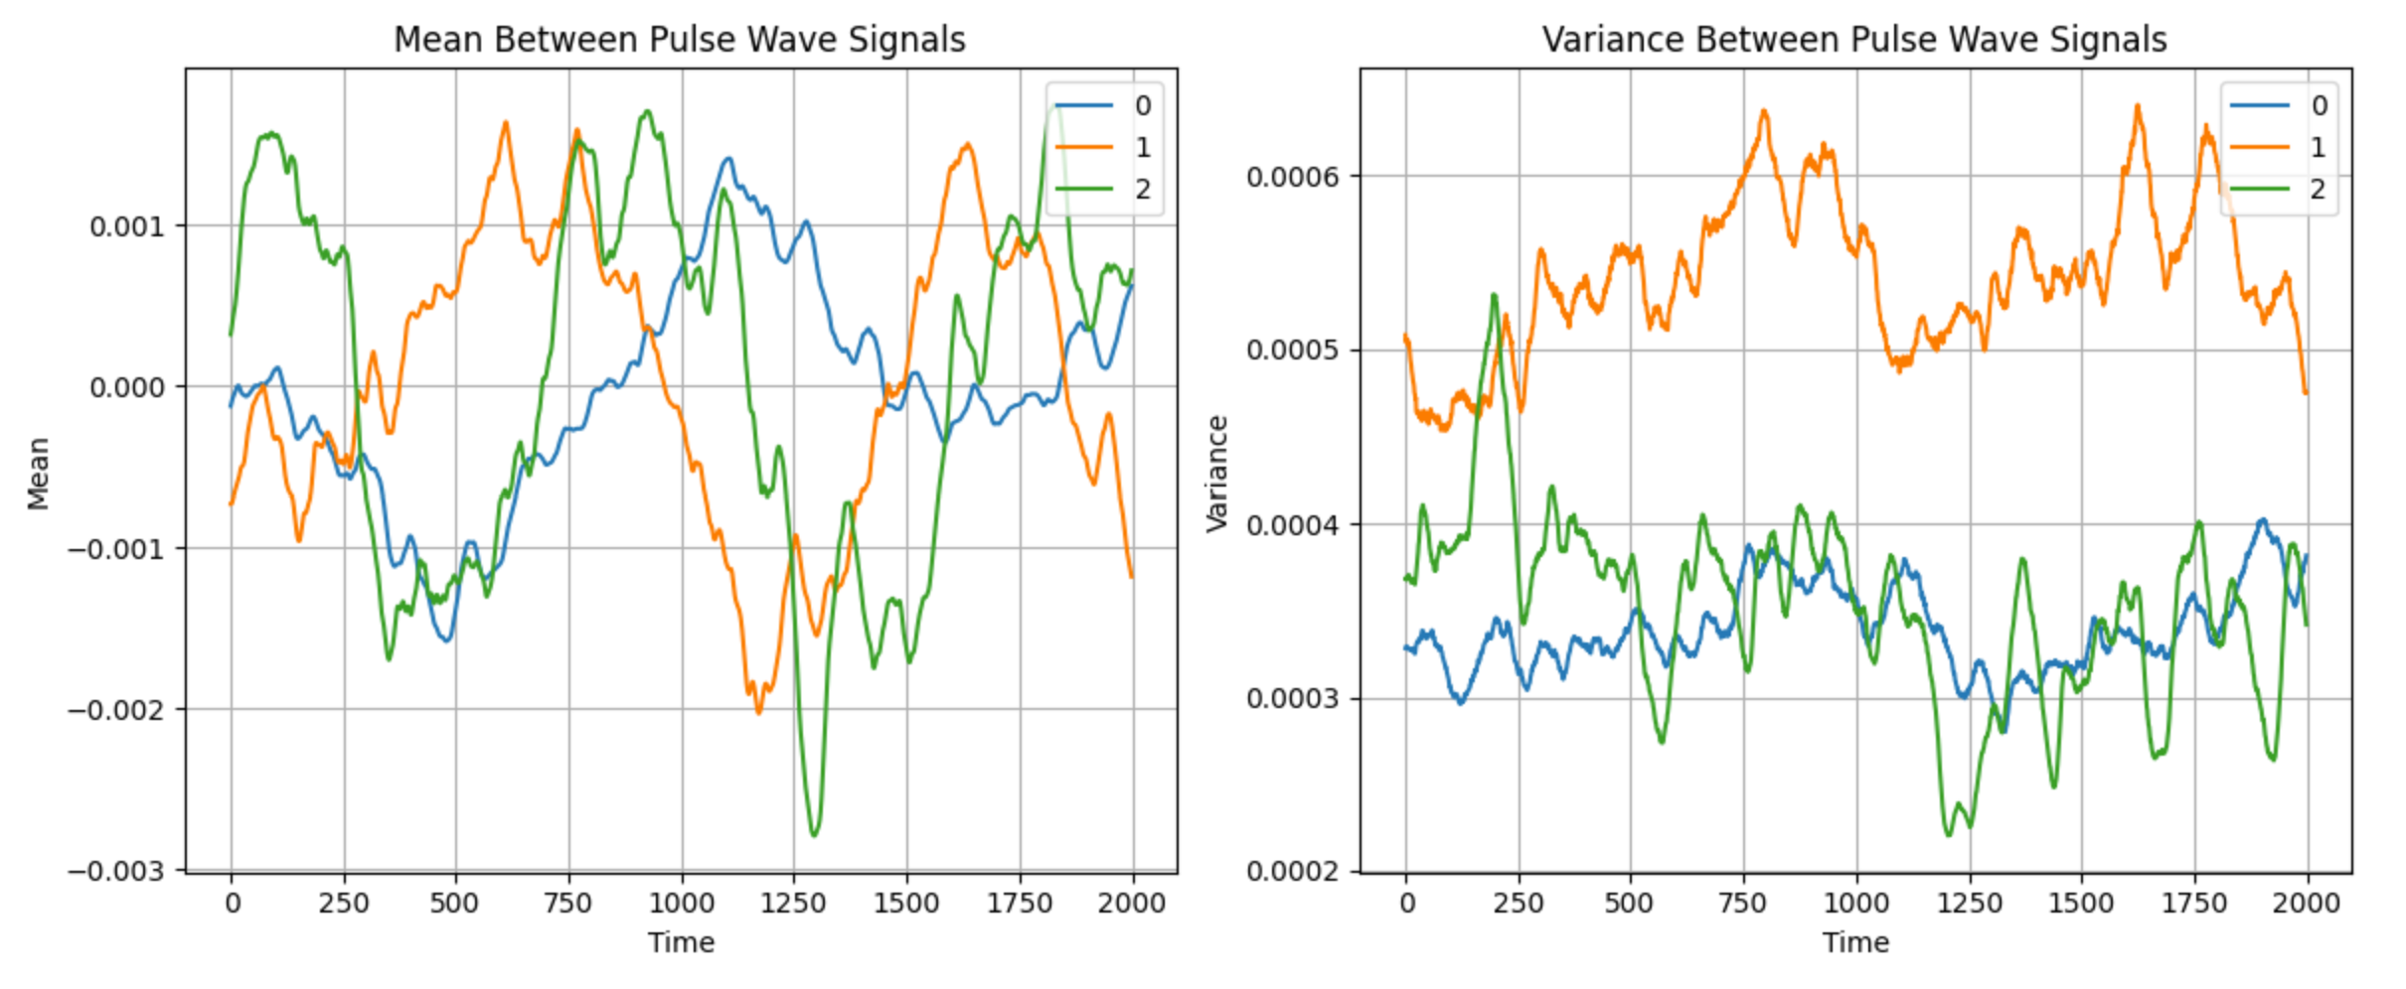
Data Variance&Mean
3 LABELS CLASSIFICATION

Slide 12
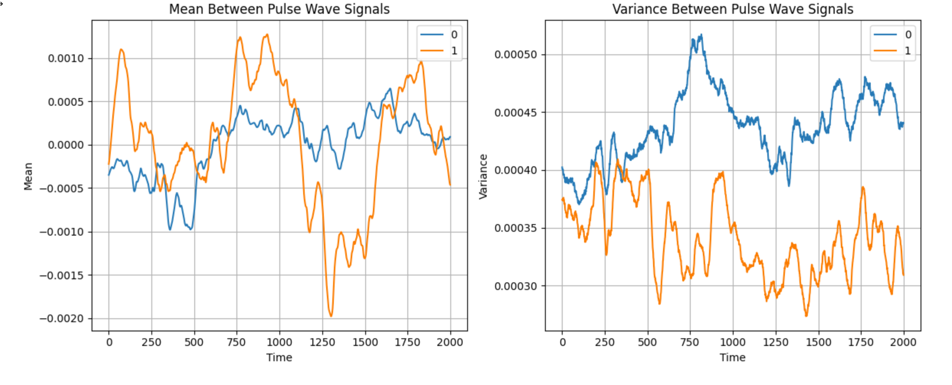
Data Variance&Mean
BINARY CLASSIFICATION

Slide 13

DL Models
CNN LSTM
ClassifierCNN
Transformer

Slide 14

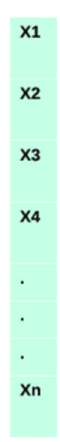
DL Models
CNN-LSTM
WHY
Sequential Data Handling
Hierarchical Features
Flexibility
Effective Feature Extraction
4 convolutional layers
LSTM Layer
Output Layer (after SoftMax/Sigmoid activation)
Input data – 1D arrays
FC layer

Slide 15
DL Models
ClassifierCNN
WHY
Hierarchical Feature Learning
Scalability and Efficiency Flexibility
4 Convolutional Layers
Adaptive Average Pooling
Linear FC
Output Layer (after SoftMax/Sigmoid Activation)
Input data – 1D arrays

Slide 16
DL Models
TRANSFORMER
WHY
Attention Mechanism
Variable Input Length
Hierarchical Features
Input data - 1D
arrays of 2000
samples. One
at a time
Embedding
Layer
Transformer
Encoder
Global max pooling
Dropout
FC Layer
Output Layer (after SoftMax/Sigmoid activation)

Slide 17
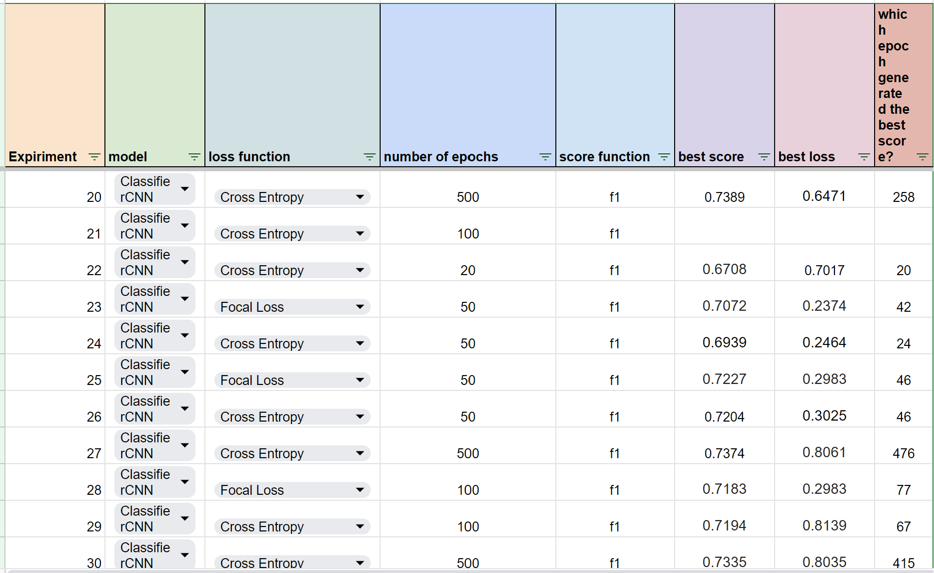

Experiments
F1
Train <> Validation <> Test

Slide 18

Roc curve
Models Evaluation
Confusion Matrix
Recall
Precision
Accuracy

Slide 19
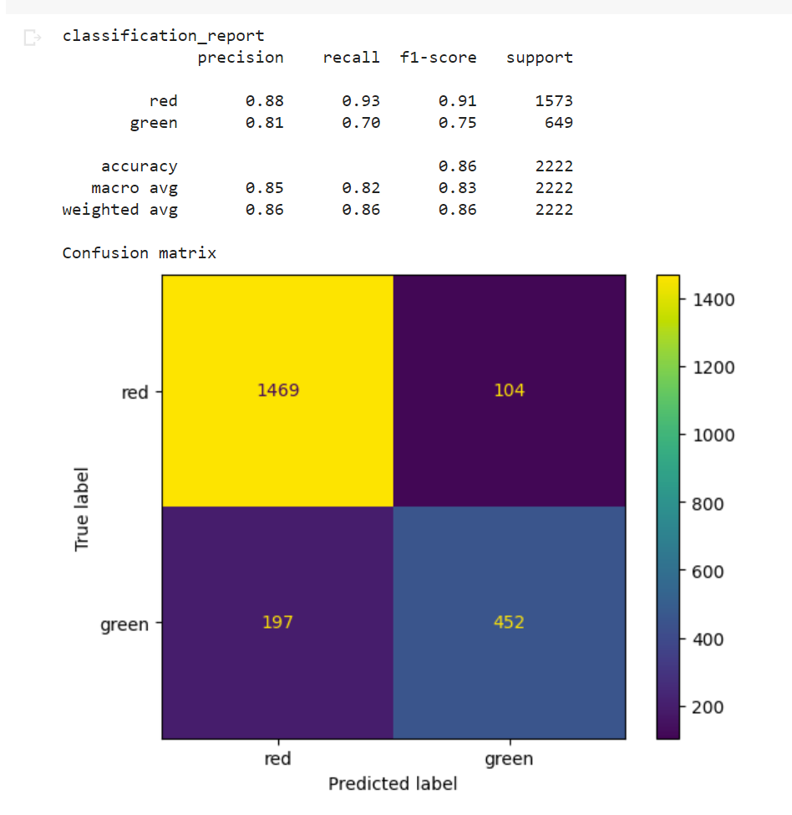

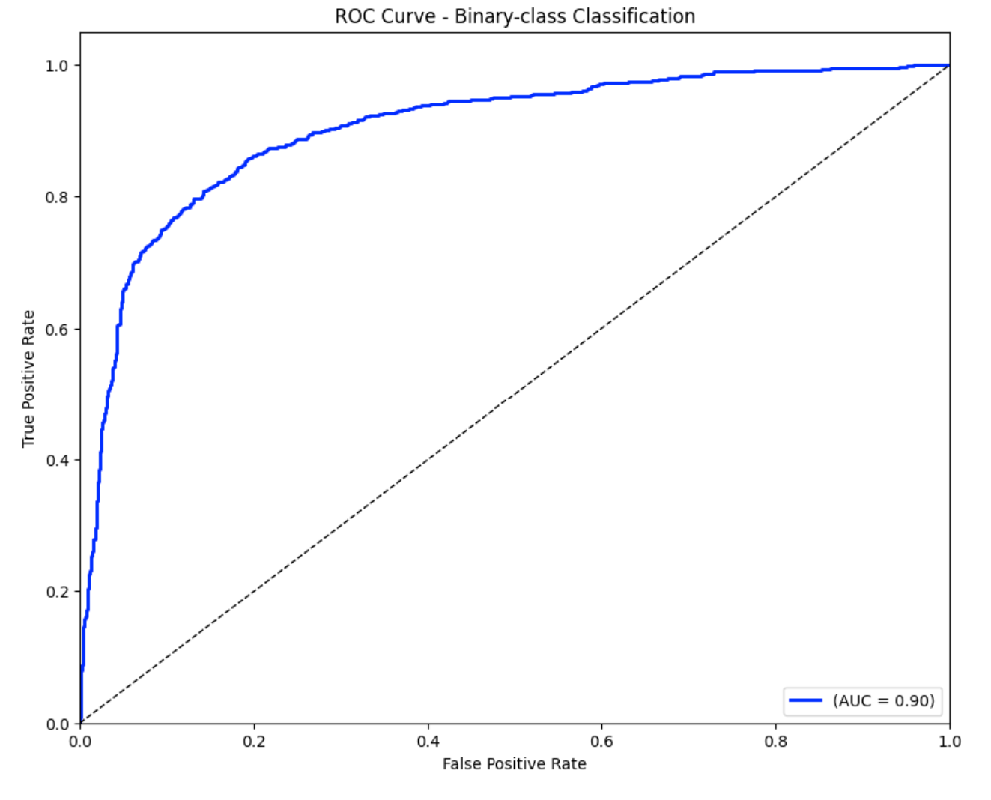
Models Evaluation
BINARY CLASSIFICATION
Model: CNN_LSTM
Loss Function: BCELoss
Number of epochs: 100
Score Function: f1
Best validation score: 0.8644

Slide 20
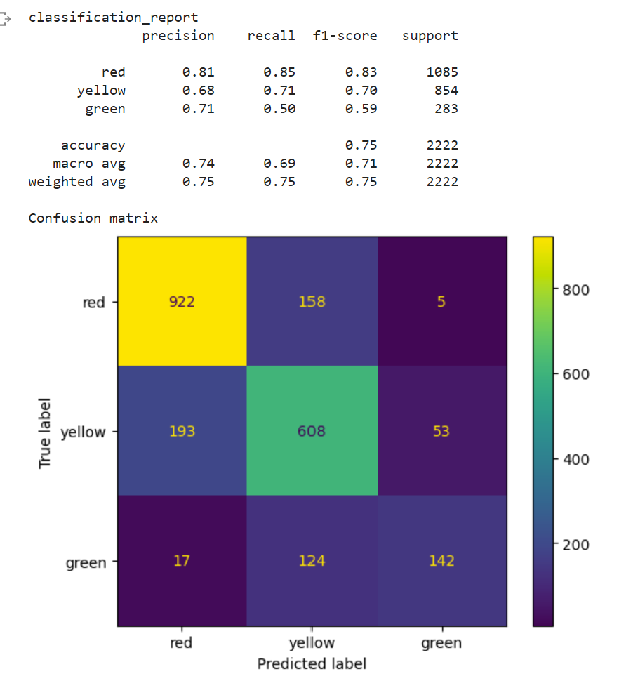
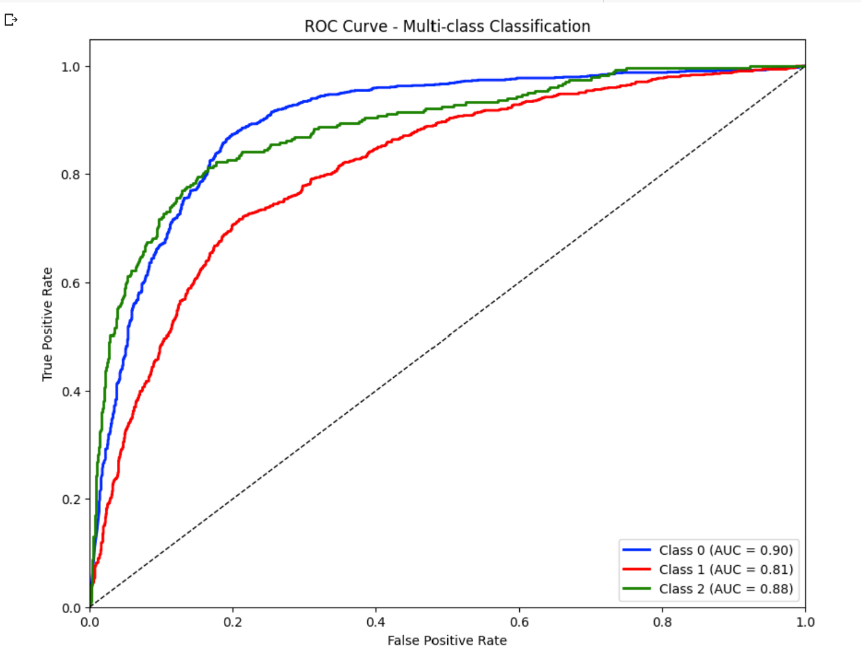
Models Evaluation
3 LABELS CLASSIFICATION
Model: ClassifierCNN
Loss Function: CrossEntropy
Number of epochs: 500
Score Function: f1
Best validation score: 0.7335

Slide 21
Conclusion & Future Work
Conclusion: The recorded data was significantly affected by high levels of noise, which posed a considerable challenge for the models during analysis.
Recommendation: Consider recording data from individuals in non-clinical settings, such as those working in a relaxed environment.
Conclusion: The tagging process was conducted subjectively, involving four different individuals who tagged different waves. As a result, the reliability of the tagged data may be compromised due to varying interpretations.
Recommendation: Appoint a single individual for tagging to maintain consistency and reduce bias arising from multiple taggers.
Conclusion: The data was significantly affected by noise and variations in pulse wave patterns between the peaks.
Recommendation: consider a preprocessing step that involves isolating and retaining only the desired peaks of the pulse waves. This approach will help remove noise and ensure that the data primarily consists of relevant pulse wave information

Slide 22
Conclusion & Future Work
Conclusion: All three models yield comparable scores
Recommendation: Explore alternative models and techniques, such as spectrograms and FFT.

Slide 23
Many Thanks!
To Avertto, and the it’s wonderful people:
Hila Leor Ori Sam Samuel
You’re making the world a better place!

